Slide 1

Web Dev II - Final Project
REAL ESTATE WEB APPLICATION
Karina de Vargas Pereira, Bo Kyung Kim, Xing Huang

Slide 2
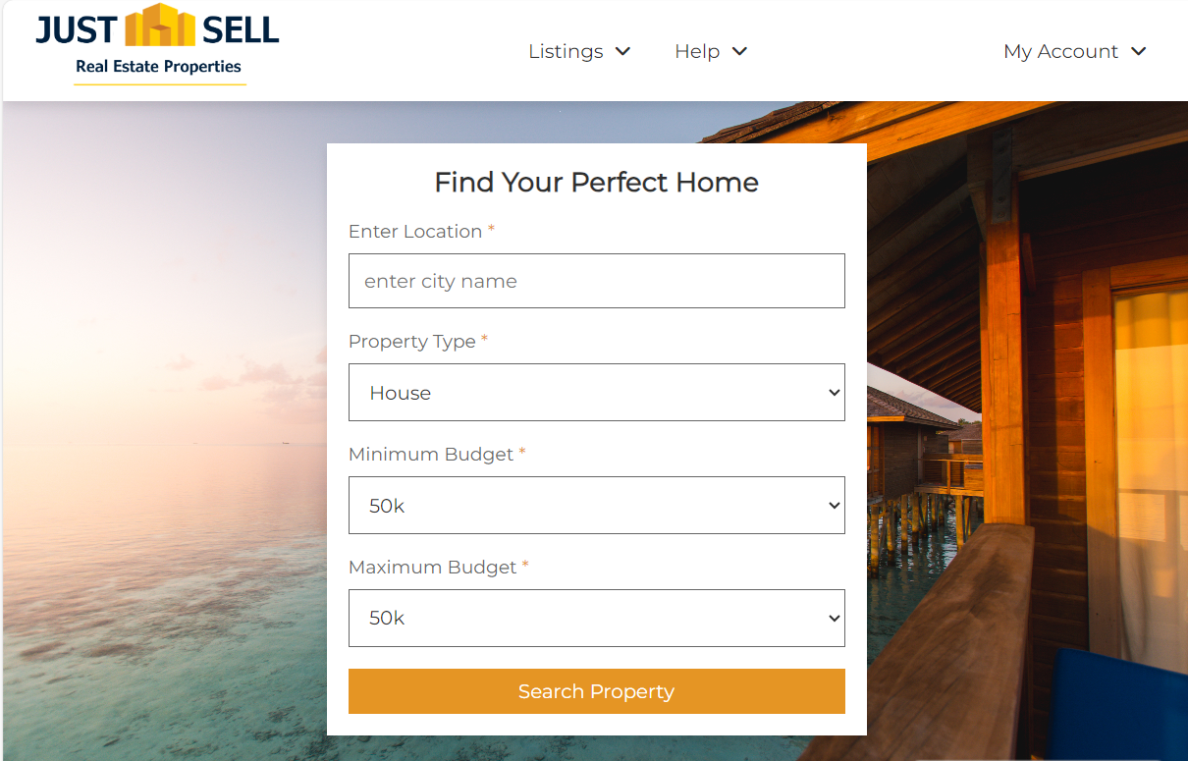

I BACKGROUND
Web Dev I Project from Karina’s team

Slide 3
I SOLUTION OVERVIEW
Register account
Login
Client
View all property listings
Search property
with a filter
Realtor
Send Offer
(by down payment)
Create/edit/delete
property
Upload files
Admin
View/edit/delete
user’s account

Slide 4
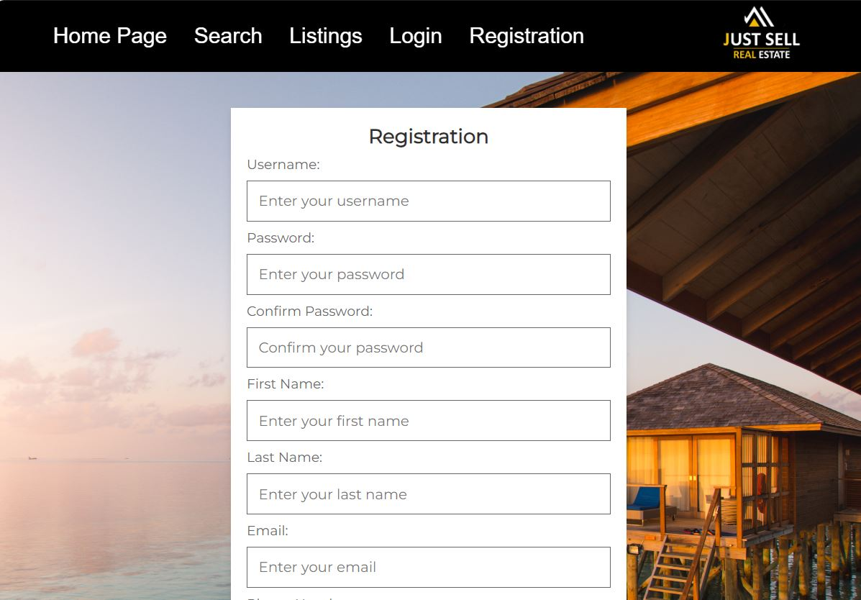
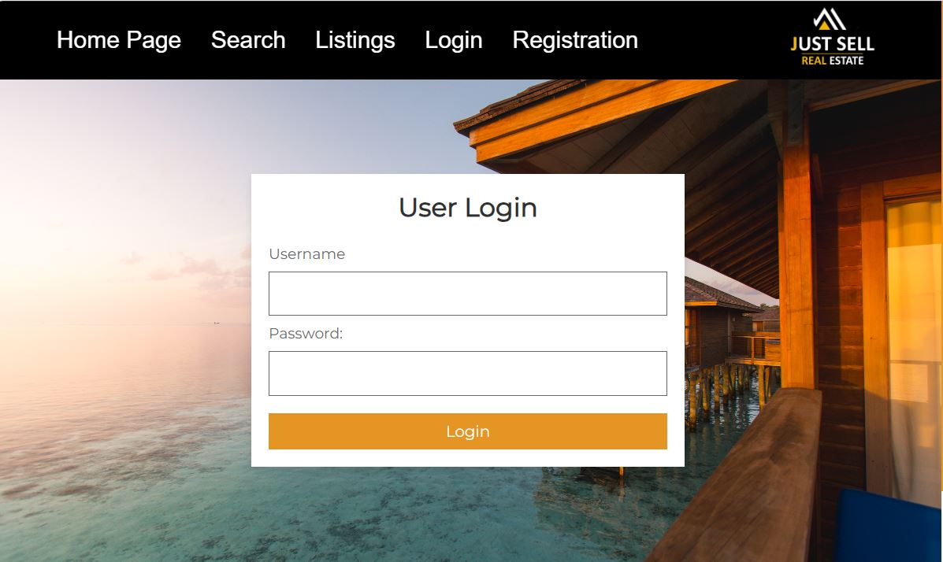
I Features for all users
Login
Registration

Slide 5
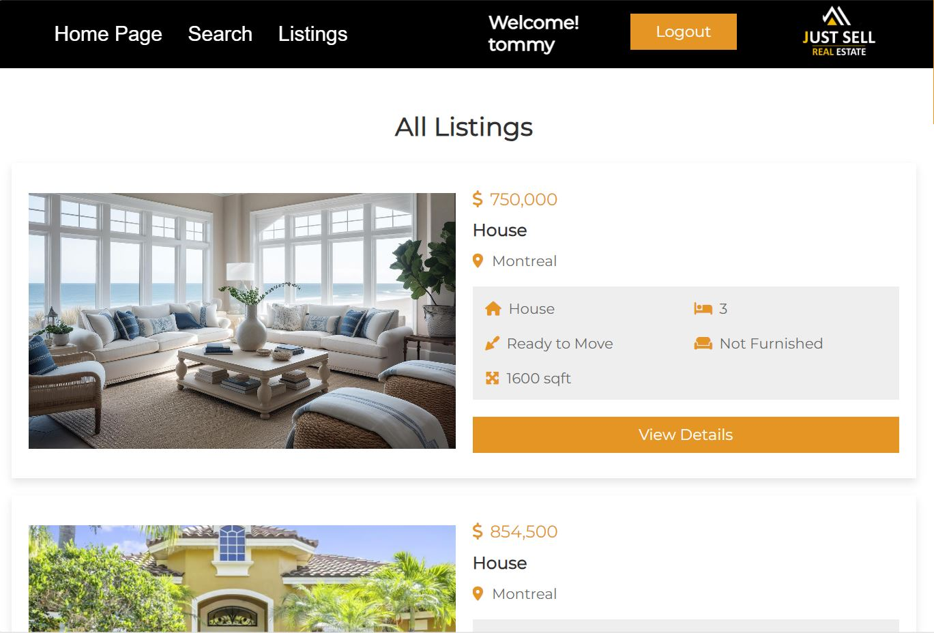
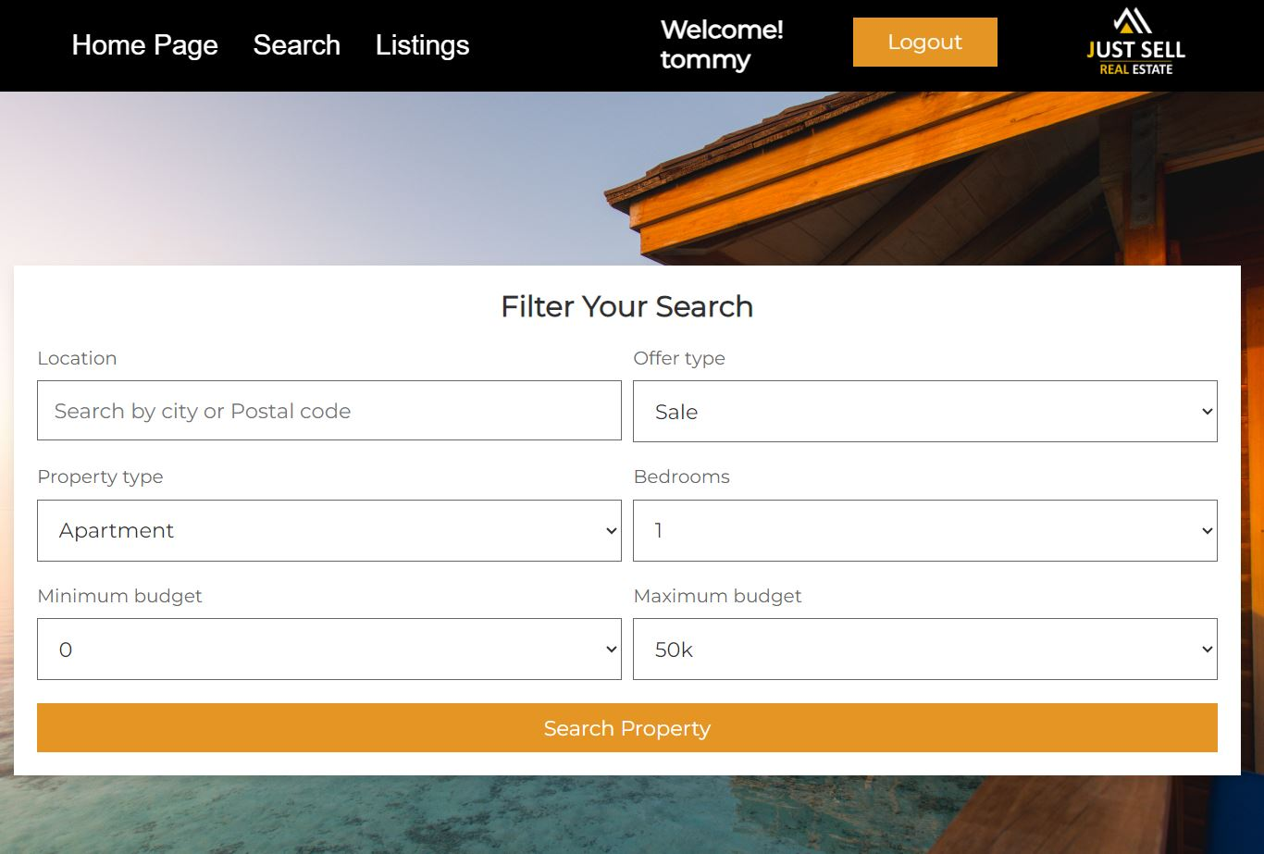
I Features for all users
View Listings
Search Property

Slide 6
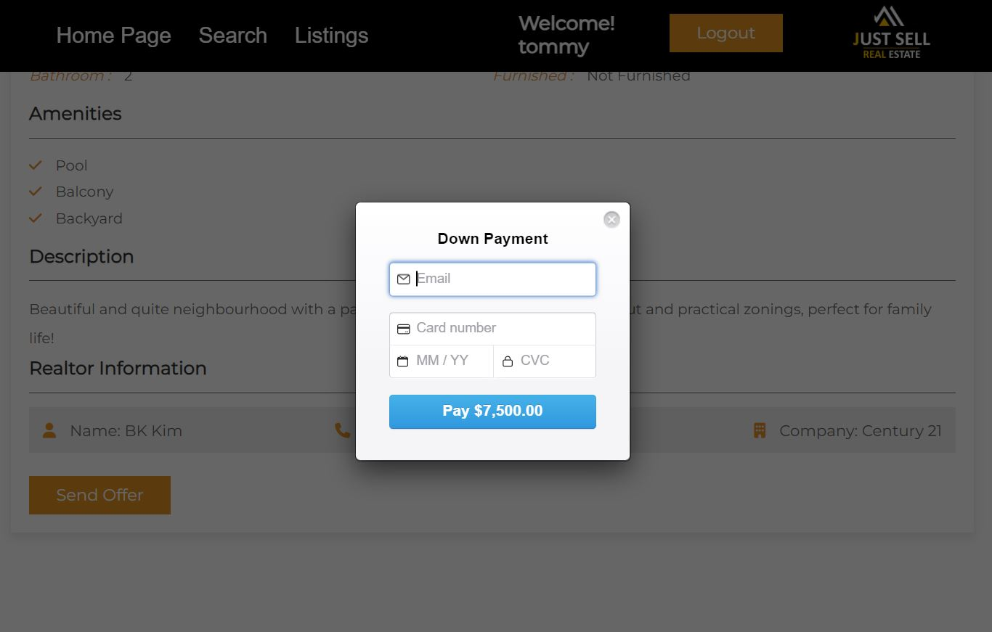
I Features for Client
Down Payment

Slide 7
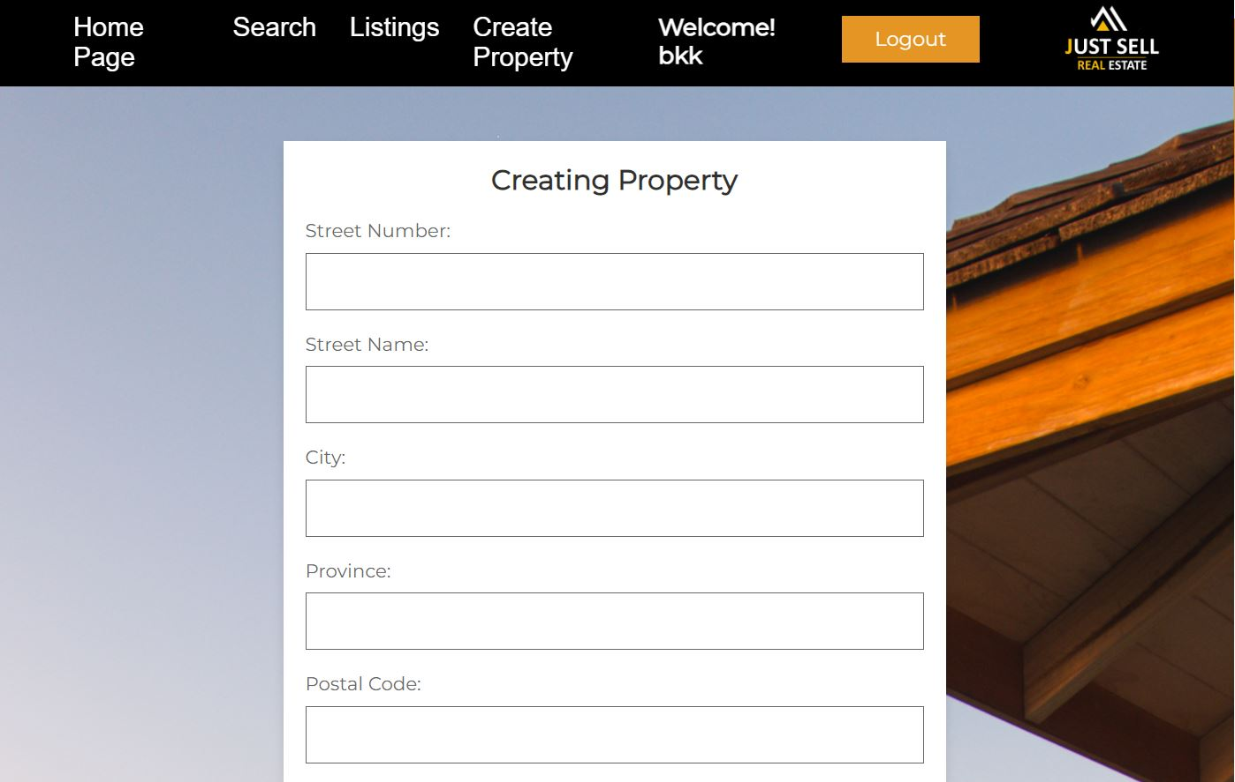
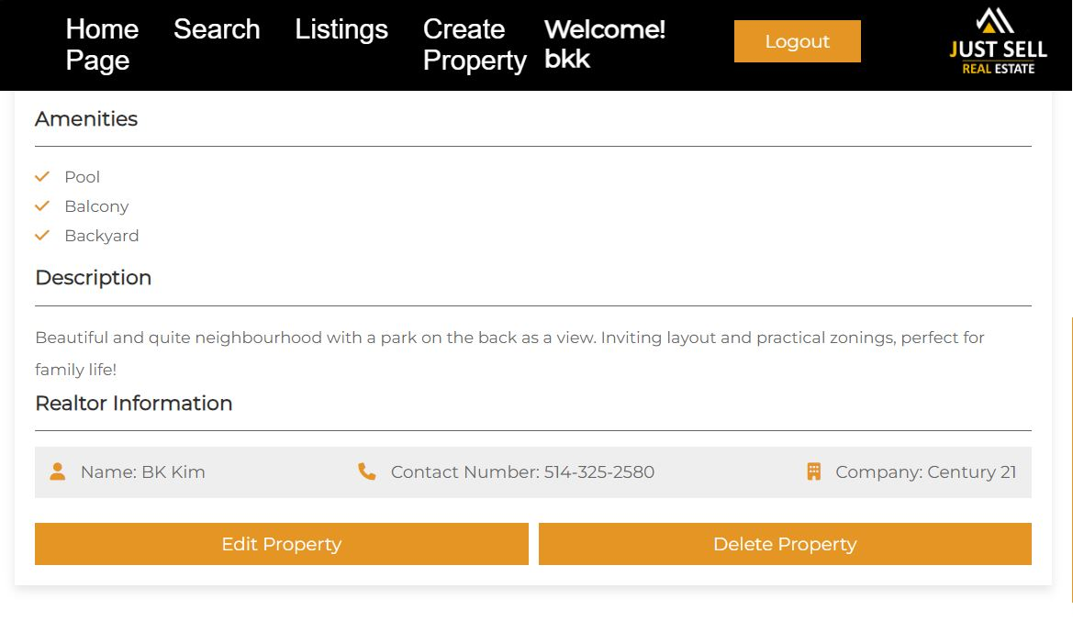
I Features for Realtor
Create Property
Edit/Delete Property

Slide 8
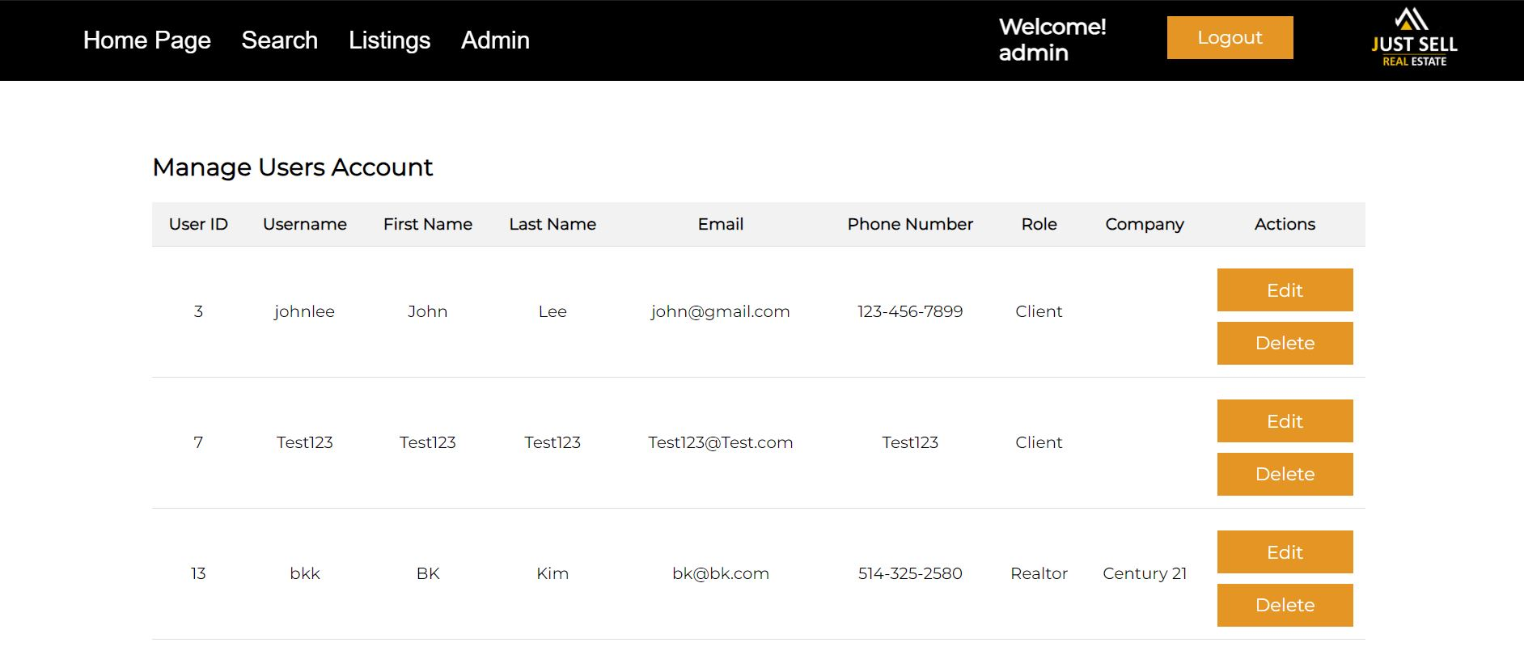
I Features for Admin
Edit/Delete User

Slide 9
I Roles & Responsibilities
Karina
Bo Kyung
Xing
- Database Setup
- Home page
- Navigation Bar - Login page
- Registration page
- Listings page
- Property page
- Create/edit
property page
- Admin page
- Edit user page
- Search page
- Payment function
- File upload function
for property page

Slide 10
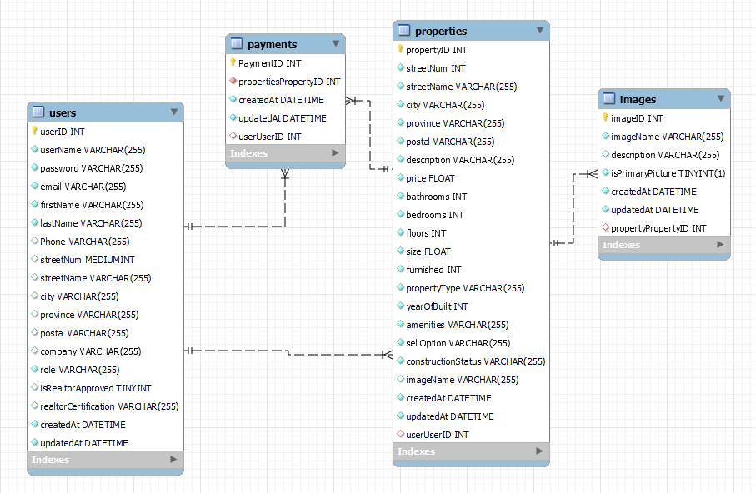
Challenges and Solutions
Web Dev II - Final Project
Web Dev II - Final Project
REAL ESTATE WEB APPLICATION
Karina de Vargas Pereira, Bo Kyung Kim, Xing Huang

Slide 11
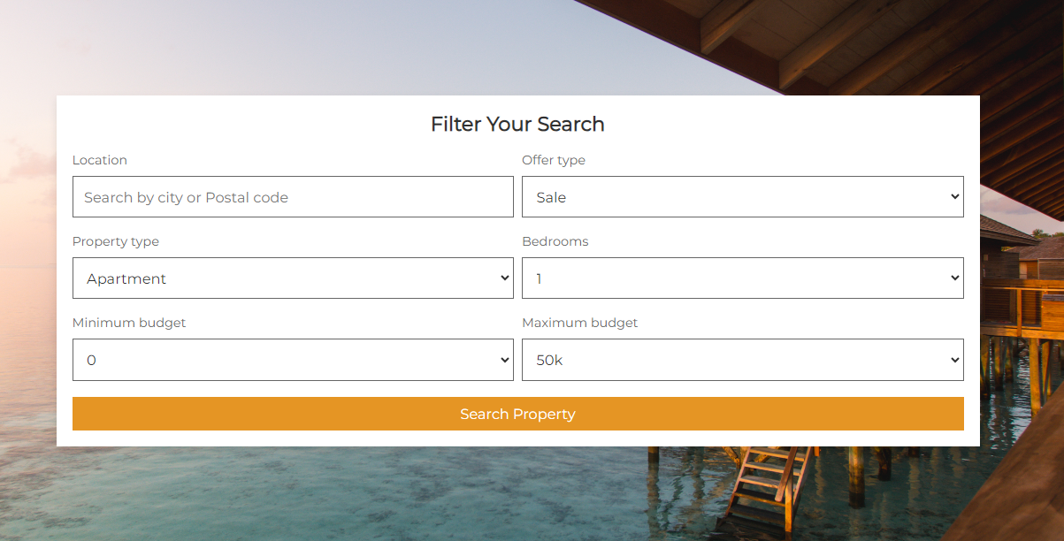
User can search properties using filters: Robust Search Functionality
Web Dev II - Final Project
REAL ESTATE WEB APPLICATION
Karina de Vargas Pereira, Bo Kyung Kim, Xing Huang

Slide 12
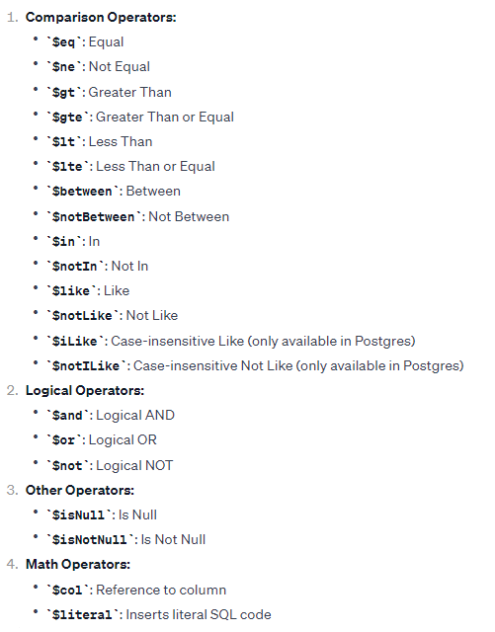
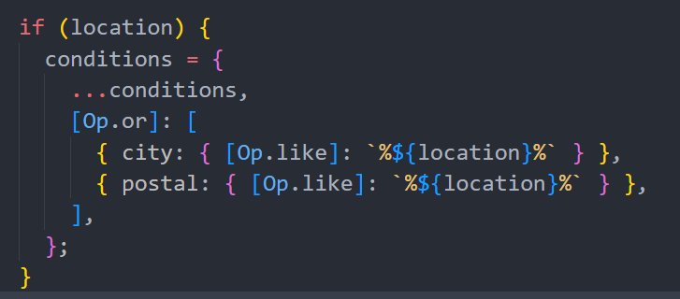
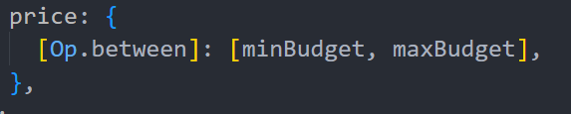
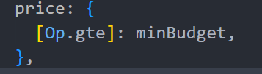
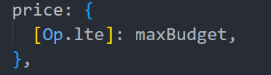
Sequelize
Web Dev II - Final Project
REAL ESTATE WEB APPLICATION
Karina de Vargas Pereira, Bo Kyung Kim, Xing Huang

Slide 13




Amazon S3 Integration
Web Dev II - Final Project
Configuration of S3 bucket
REAL ESTATE WEB APPLICATION
Karina de Vargas Pereira, Bo Kyung Kim, Xing Huang

Slide 14
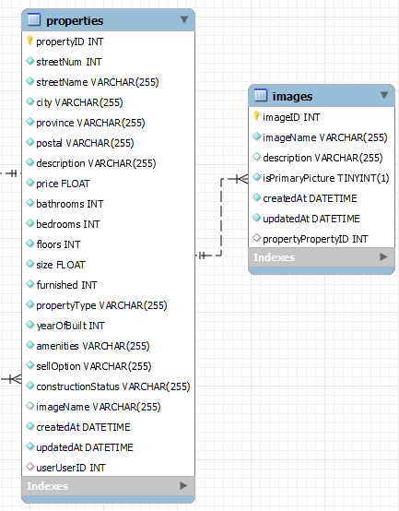
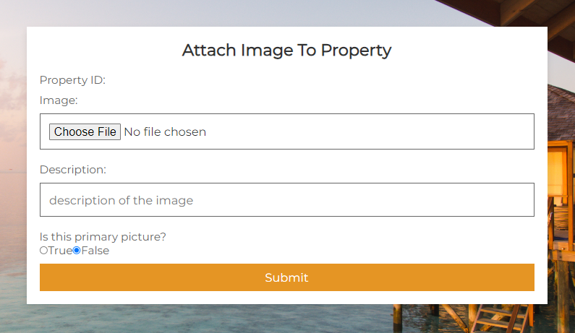
Web Dev II - Final Project
REAL ESTATE WEB APPLICATION
Karina de Vargas Pereira, Bo Kyung Kim, Xing Huang

Slide 15



@aws-sdk/client-s3
@aws-sdk/s3-request-presigner
Web Dev II - Final Project
REAL ESTATE WEB APPLICATION
Karina de Vargas Pereira, Bo Kyung Kim, Xing Huang
Form encoding type:
multipart/form-data
Multer: handling multipart/form-data
Crypto: generate random unique filename
Sharp: resizing the file

Slide 16
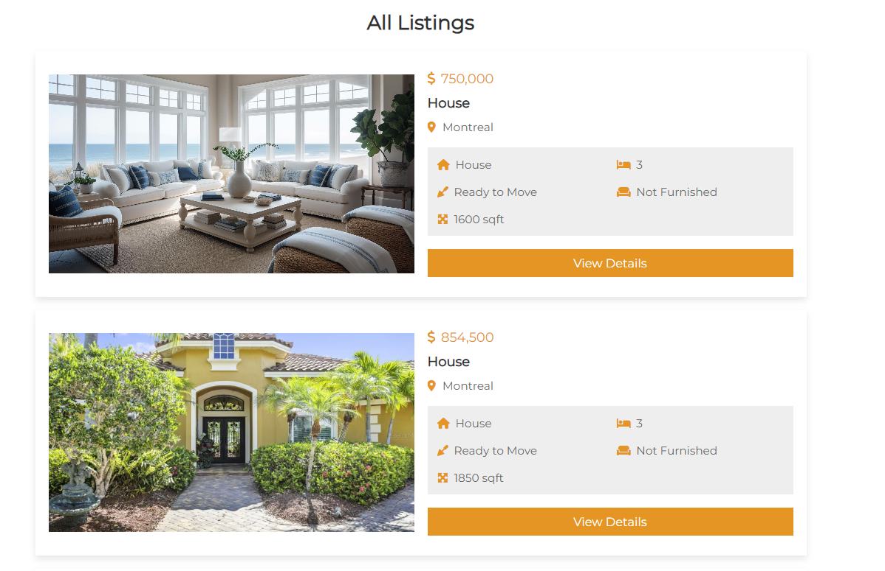
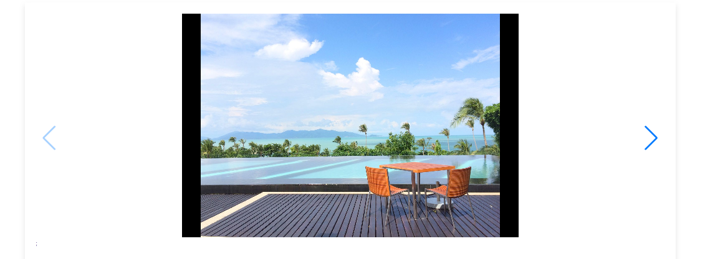
Web Dev II - Final Project
REAL ESTATE WEB APPLICATION
Karina de Vargas Pereira, Bo Kyung Kim, Xing Huang

Slide 17
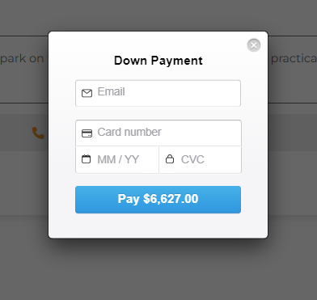
Online Payment Capabilities
react-stripe-checkout
Stripe Node.js Library
Web Dev II - Final Project
REAL ESTATE WEB APPLICATION
Karina de Vargas Pereira, Bo Kyung Kim, Xing Huang

Slide 18
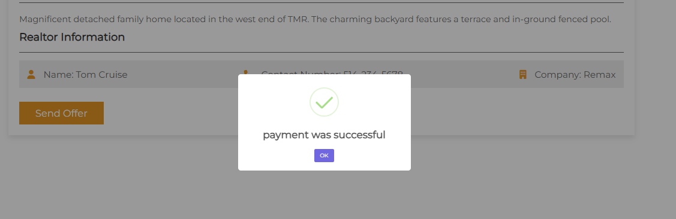
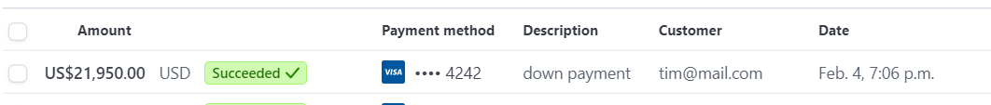
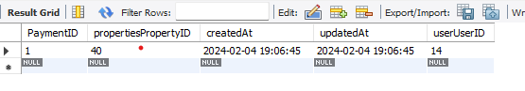
Web Dev II - Final Project
REAL ESTATE WEB APPLICATION
Karina de Vargas Pereira, Bo Kyung Kim, Xing Huang

Slide 19
Deployment:
Server--Heroku CI/CD
Client – Netlify
MySql—AWS RDS
Web Dev II - Final Project
REAL ESTATE WEB APPLICATION
Karina de Vargas Pereira, Bo Kyung Kim, Xing Huang

Slide 20
Future work
Just sell backlog.
Time management
improvements

Slide 21
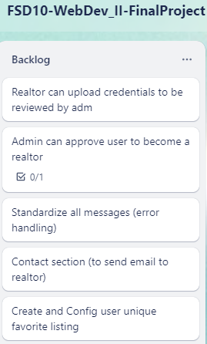
Trello backlog

Slide 22
If granted an additional week, our team could integrate a feature into our application, allowing Realtors to upload their credentials for approval by the admin.
Secure and user-friendly credential uploading mechanism

Slide 23
Implementation of "Contact Us" page:
open communication between clients and the responsible realtors for specific properties
Creation of "favorite" button and list:
allowing users to bookmark and organize properties of interest
enhance user experience
providing a convenient way for clients to keep track of their preferred listings

Slide 24
Summary:
User Authentication & Registration:
Home Access & Project Setup:
Admin User Management:
Mobile-Friendly Design:
Role-Based Navbar Display:
Realtor Property Management:
Payment Processing:
User Login & Property Search:
Realtor Property Editing

Slide 25
Questions?

Slide 26
Thank you!

